Slide 1
Automated Data Augmentation for Medical Image Segmentation
胡敬玉

Slide 2
目录
研究背景
文献综述
研究目标
研究方法
研究计划

Slide 3
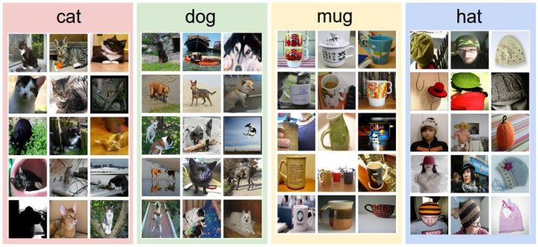
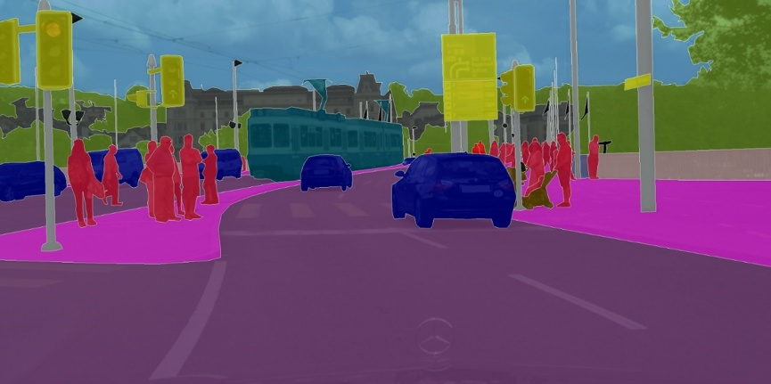
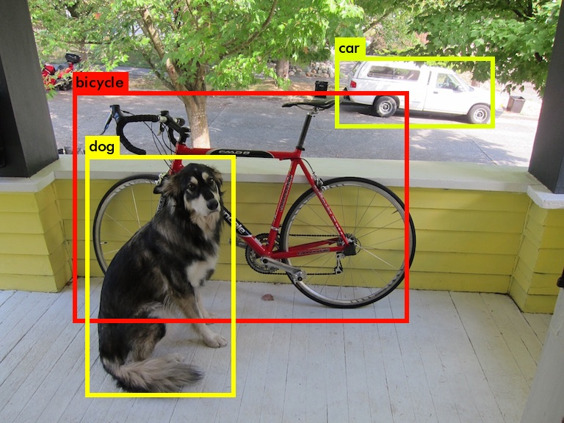
背景
深度学习在多种视觉任务上取得了出色的结果。
图像分类
目标检测
图像分割
Supervised Learning
Labeled Big Data

Slide 4
背景
难以获取大量的高质量的标签数据
数据增广（增强）
手动地数据增强仍然需要基于数据集的先验知识，自动数据增强则不需要，同时自动数据增强在图像分类任务上展现出出色的性能，在图像分割任务上还没有充分的研究。

Slide 5
文献综述
Data Augmentation for Medical image
Flipping the image horizontally
Adding noise
Scaling
Rotating
Shearing
Dosovitskiy 等人的研究表明数据增强能够帮助网络学习到数据的不变性
GAN-based Augmentations
A. Dosovitskiy, J. T. Springenberg, M. Riedmiller, and T. Brox, “Discriminative Unsupervised Feature Learning with Convolutional Neural Networks,” p. 9.
T. Schlegl, P. Seeböck, S. M. Waldstein, U. Schmidt-Erfurth, and G. Langs, “Unsupervised Anomaly Detection with Generative Adversarial Networks to Guide Marker Discovery,” in Information Processing in Medical Imaging, vol. 10265

Slide 6
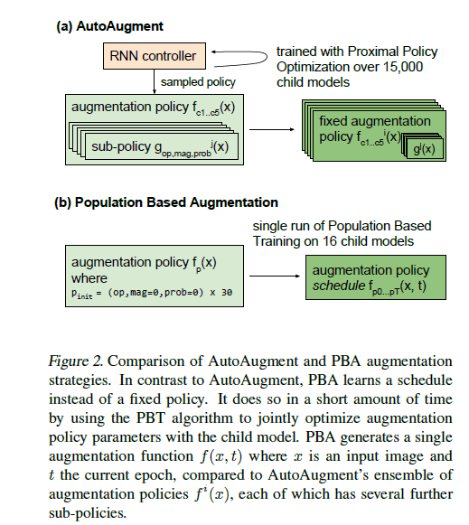
文献综述
Automated Data Augmentation
AutoAugment
Population Based Augmentation
Fast Augmentation
AutoAugment for Object Detection
E. D. Cubuk, B. Zoph, D. Mane, V. Vasudevan, and Q. V. Le, “AutoAugment: Learning Augmentation Strategies From Data,” p. 11.
D. Ho, E. Liang, I. Stoica, P. Abbeel, and X. Chen, “Population Based Augmentation: Efficient Learning of Augmentation Policy Schedules,” p. 11.
S. Lim, I. Kim, T. Kim, C. Kim, and S. Kim, “Fast AutoAugment,” arXiv:1905.00397 [cs, stat], May 2019.
4. B. Zoph, E. D. Cubuk, G. Ghiasi, T.-Y. Lin, J. Shlens, and Q. V. Le, “Learning Data Augmentation Strategies for Object Detection,” arXiv:1906.11172 [cs], Jun. 2019.

Slide 7
研究目标
Main Goal
Investigating the automated data augmentation for medical image segmentation.
Specific Goals
1. According to the anatomical property of medical image, we choose some data augmentations to create a search space.
2. Learning better automated data augmentation policies to improve the performance of medical image segmentation such as brain tumor segmentation, brain tissue segmentation.
3. To reduce the time consumption of searching augmentation policies, we need to investigate the new algorithm to generate augmentation policy.

Slide 8
研究方法
3.1 Choosing Data Augmentations to Create a Search Space
According to the characteristics of medical images, unique data augmentations for medical image segmentation will be considered to create a search space.
3.2 Learning Augmentation Policies for Medical Image Segmentation
The baseline model for medical image segmentation will be constructed such as U-Net[12]. Then, Fast AutoAugmentation[11] will be extended to medical image segmentation with segmentation baseline model.
3.3 Transferring Augmentation Policies to Other Medical Image Dataset
The learned augmentation polices will be used to another different medical image segmentation dataset to evaluate the transferability.
3.4 GAN-based Augmentation
GAN can effectively generate new samples to enlarge dataset, achieving better performance on many visual tasks.

Slide 9
研究计划及进度
Oct. 2020-Sept. 2020: Literature review
­Sept. 2020-Nov. 2020: Choosing data augmentations to create a search space.
Nov. 2020-Dec. 2020: Constructing baseline models for medical image segmentation
Dec. 2020-Feb. 2021: Learning data augmentation policies from the search space on baseline models
Feb. 2021-Mar. 2021: Transferring learned data augmentation policies to other medical image datasets
Mar. 2021-Apr. 2021: Writing a paper to summarize the work above
Apr. 2021-Jun. 2021: Experiments on GAN-based methods to enlarge dataset
Jun. 2021-Aug. 2021: Writing a paper about GAN-based data augmentation for medical image segmentation

Slide 10
Thank You!

